Slide 1
Data Management
Huw Fryer
hf1g10@ecs.soton.ac.uk
Electronics and Computer Science

Slide 2
ANNOUNCEMENT
For the next two weeks, the tutorial on Friday afternoon will be in the Zepler computer labs 59/2203
We will meet on Level 2 South – the electronics lab
Your cards probably won’t work, so I will let you in

Slide 3
Introduction to Data Management
Not all of data science is doing fancy algorithms and visualisations
There needs to be some way of storing, accessing, and updating the data
This is a significant part of the Data Science Pipeline

Slide 4
This Lecture
Relational Databases
NoSQL Databases
Introduction to MongoDB and PyMongo
Choosing a database
A bit about the tutorial…

Slide 5
Relational Databases
A relational database stores data according to the relational model
A series of tables with rows, where each is identified by a key
Avoids data duplication through normalisation
Frequent use of joins to extract data
Uses Structured Query Language (SQL)

Slide 6
Non-relational Data
Consider the problem of using a single table to store information
Consider the example of a list of users with their DVD collection, starting like this
username | first_name | surname | dvd_title | year | starring
huwfryer | Huw | Fryer | The Naked Gun | 1988 | Leslie Nielsen

Slide 7
Non-relational Data
But The Naked Gun also has other stars…
username | first_name | surname | dvd_title | year | starring
huwfryer | Huw | Fryer | The Naked Gun | 1988 | Leslie Nielsen
huwfryer | Huw | Fryer | The Naked Gun | 1988 | Priscilla Presley
huwfryer | Huw | Fryer | The Naked Gun | 1988 | Ricardo Montalban
huwfryer | Huw | Fryer | The Naked Gun | 1988 | George Kennedy
huwfryer | Huw | Fryer | The Naked Gun | 1988 | O.J. Simpson

Slide 8
Non-relational Data
And I might have more than one DVD!
username | first_name | surname | dvd_title | year | starring
huwfryer | Huw | Fryer | The Naked Gun | 1988 | Leslie Nielsen
huwfryer | Huw | Fryer | The Naked Gun | 1988 | Priscilla Presley
huwfryer | Huw | Fryer | The Naked Gun | 1988 | Ricardo Montalban
huwfryer | Huw | Fryer | The Naked Gun | 1988 | George Kennedy
huwfryer | Huw | Fryer | The Naked Gun | 1988 | O.J. Simpson
huwfryer | Huw | Fryer | The Naked Gun 2½ | 1991 | Leslie Nielsen

Slide 9
Non-relational Data
The grey data is all duplicated!
username | first_name | surname | dvd_title | year | starring
huwfryer | Huw | Fryer | The Naked Gun | 1988 | Leslie Nielsen
huwfryer | Huw | Fryer | The Naked Gun | 1988 | Priscilla Presley
huwfryer | Huw | Fryer | The Naked Gun | 1988 | Ricardo Montalban
huwfryer | Huw | Fryer | The Naked Gun | 1988 | George Kennedy
huwfryer | Huw | Fryer | The Naked Gun | 1988 | O.J. Simpson
huwfryer | Huw | Fryer | The Naked Gun 2½ | 1991 | Leslie Nielsen

Slide 10
The Relational Database Method
We split the concept of a user and the concept of a DVD into different tables
We use a primary key to uniquely identify each record
User
user_id
username
first_name
surname
DVD
dvd_id
title
year
Primary
keys

Slide 11
The Relational Database Method
And we join these tables to represent the concept of someone owning a DVD
These have foreign keys, which uniquely identify a row in the other table
User
user_id
username
first_name
surname
DVD
dvd_id
title
year
UserDVD
user_dvd_id
user_id
dvd_id
Foreign
Keys

Slide 12
The Relational Database Method
And we can do the same thing for the movie stars as well…
DVD
dvd_id
title
year
Stars
star_id
first_name
surname
DVDStar
dvd_star_id
dvd_id
star_id
Foreign
Keys

Slide 13
The Relational Database Method
Instead we have 5 small tables:
user_id | username | first_name | surname
1 | huwfryer | Huw | Fryer
dvd_id | title | year
1 | The Naked Gun | 1988
2 | Naked Gun 2½ | 1991
user_dvd_id | user_id | dvd_id
1 | 1 | 1
2 | 1 | 2

Slide 14
The Relational Database Method
Instead we have 5 small tables:
star_id | first_name | surname
1 | Leslie | Nielsen
2 | Priscilla | Presley
3 | Ricardo | Montalban
4 | George | Kennedy
5 | O.J. | Simpson
dvd_star_id | dvd_id | star_id
1 | 1 | 1
2 | 1 | 2
3 | 1 | 3
4 | 1 | 4
5 | 1 | 5
6 | 2 | 1

Slide 15
Relational Database Guarantees
Atomicity – either the whole transaction succeeds or none of it succeeds
Consistency – Any transaction can only affect the system in defined ways
Isolation – Change by one user should not affect change by another user
Durability – transactions which have committed will survive permanently

Slide 16
NoSQL Databases
Not [necessarily] using SQL or a relational model
Allows an alternative focus for some of the guarantees
Basically Available, Soft state, Eventual consistency model (BASE)
Brewer’s CAP Theorem

Slide 17
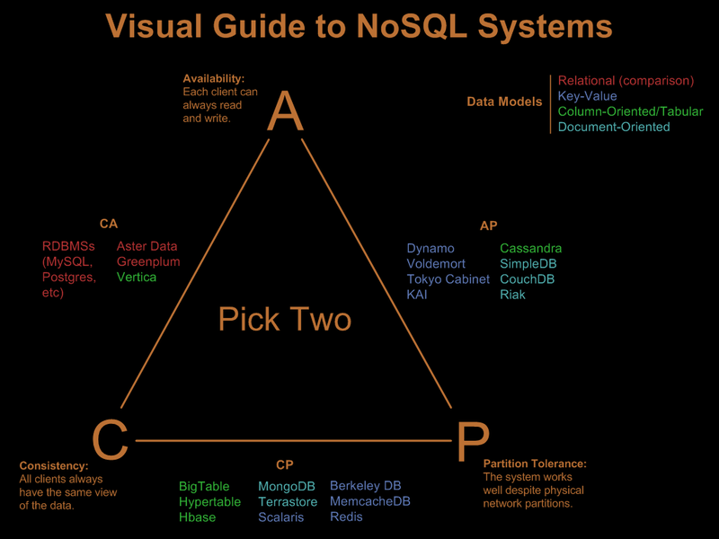
Brewer’s CAP Theorem
http://blog.nahurst.com/visual-guide-to-nosql-systems

Slide 18
Brewer’s CAP Theorem - Limitations
The definitions used are not the same as in the ACID definition
Partitions are network failures – not something you can opt out of!
And does not include latency!
We can have degrees of each property, and products which don’t fit any two nicely
Was only intended as a means of discussing trade-offs in distributed systems

Slide 19
Types of NoSQL Databases
Key/Value – Uses a hash table data structure with a pointer to a data item
Document-based – Collections of key/value pairs as “documents” e.g., JSON
Column-based – Data are grouped in columns of data rather than rows
Graph-based – Represents data using nodes and edges

Slide 20
MongoDB
MongoDB is an example of a NoSQL database
Name derived from the word Humongous
It has a document-based storage model rather than a relational model
Documents are stored in a JSON format

Slide 21
MongoDB Features and Trade-offs
Designed to easily support horizontal scaling by sharding
Limited support for transactions and joins
Trades additional storage requirement for speed
Moves processing to client where possible
Aggregation Framework

Slide 22
JSON & BSON
JSON is a subset of JavaScript, first defined in IETF RFC 4627 https://www.ietf.org/rfc/rfc4627.txt
Represents data with an unordered name/value pairs
MongoDB uses BSON (Binary JSON) to store data
BSON is essentially JSON, but some extra features
And some optimisation to make access faster

Slide 23
JSON Syntax
The name and value are separated by colons “:”
{“key” : “value”}
Name/value pairs are separated by commas
{“key” : “value”, “age” : 21}
Values can be a string, number, boolean, null or array
{“age” : null, “info” : [1, 23.5, 7] }
Can include objects within an object e.g.,
{“obj_key” : {“good_obj” : true} }

Slide 24
An Example JSON Object
{ “user”:
{
“username”: “littlebobbytables”, “id”: 3452,
“first_name”: “Robert”,
“surname”: “Tables”,
“pets”: [“Callie”, “Mittens”, “Ginger”],
“over_18”: true,
“active”: false
}
}

Slide 25
MongoDB Storage Structure
Collections
Database
{“name”: jane, surname: “doe”}
{“name”: jane, surname: “doe”}
{“name”: jane, surname: “doe”}
{“name”: jane, surname: “doe”}
{“name”: jane, surname: “doe”}
{“name”: jane, surname: “doe”}
{“name”: john, surname: “doe”}
{“name”: john, surname: “doe”}
Documents

Slide 26
Using MongoDB
The name of the collection you create is an object
Using dot syntax, functions on this object can be called.
E.g., the collection “collection_name” would have operations written as:
db.collection_name.<<function_name>>
For these examples, we will assume the collection is called collection_name

Slide 27
Basic Operations
Find all documents in collection_name:
db.collection_name.find();
To get all distinct records from a collection:
db.collection_name.distinct(key)
To get the amount of documents in a collection:
db.collection_name.count()

Slide 28
Queries With Conditions
Each of these functions allows conditions to be specified on queries with an object as a parameter in the format {field_name: condition}
E.g., to find all records with a surname of Doe:
db.collection_name.find( { surname : “Doe”} )

Slide 29
Queries with Multiple Conditions
It is possible to set more than one condition on a query
db.collection_name.find( { surname : “Doe”, first_name : “John”} )

Slide 30
Queries With Comparisons
MongoDB comparisons also supported
E.g., for all records with user_id > 1111:
db.collection_name.find( {user_id : {$gt : 1111});
A list of comparisons:
$eq, $gt, $gte, $lt, $lte, $ne, $in, $nin
For more detail see https://docs.mongodb.org/manual/ reference/operator/query-comparison/

Slide 31
Aggregation Framework
For doing more complex operations, e.g., grouping
db.collection_name.aggregate([ {“$match”: {“Area”: “SO16”} }, {“$group”: {“_id”: None, “average”: {“$avg”: “$salary”} } ])

Slide 32
Which System to Use?
Simple answer… It depends!
The structure of the data
Does it easily fit into a relational model, or is it more complex?
What will you be doing with the data?
Lots of reads? Lots of updates?
How “big” is the data?
How stable are the requirements?

Slide 33
Which System to Use?
Non technical issues
How comfortable are you with the different products? How easy would it be to hire someone for this
Is the company behind the particular product reputable?
Is the product well supported?
There is a huge variety of products with different trade-offs
Thinking about all these issues

Slide 34
Tutorial and Coursework
The tutorial will give you a chance to set up and perform queries against a MongoDB instance
You will be using:
Bash command line
Jupyter notebook with Jupyterhub for authentication
PyMongo/MongoDB
Has anyone not received an email about receiving a VM?

Slide 35
Tutorial Preparation
The tutorial has two sets of instructions:
There is a HTML file on Edshare which gives you instructions for setting up the server http://www.edshare.soton.ac.uk/17500
A Jupyter notebook file which you will use interactively (will be made available before the tutorial)
To connect, you will need to be on the ECS network

Slide 36
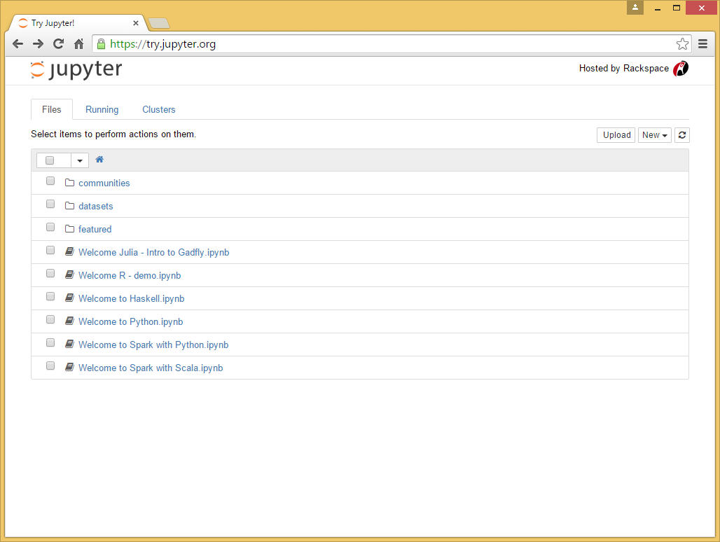
Jupyter Notebooks

Slide 37
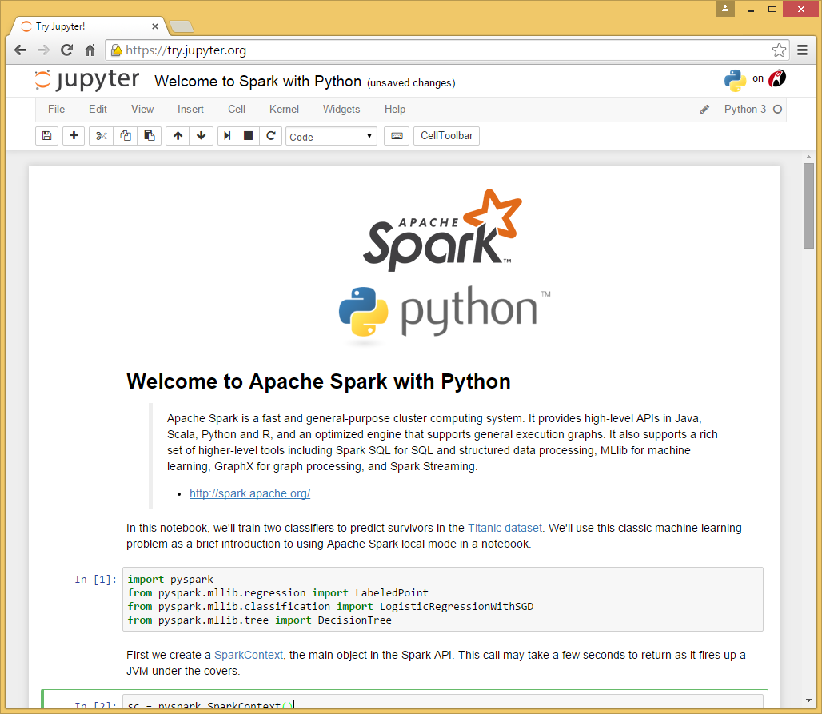
Jupyter Notebooks

Slide 38
Your Connection is not Private
You will get this message when you run Jupyterhub
This is because you are using a self-signed digital certificate
That is okay, the important thing is that you are not sending your password in plain text to the server

